Slide 1

Agrobot: Universal AI-Based Agricultural Assistant
AI-AgroBot is an AI-based agricultural assistant that uses NLP to understand farmer queries and provides intelligent solutions such as crop recommendations, disease detection, and market insights.”

Slide 2
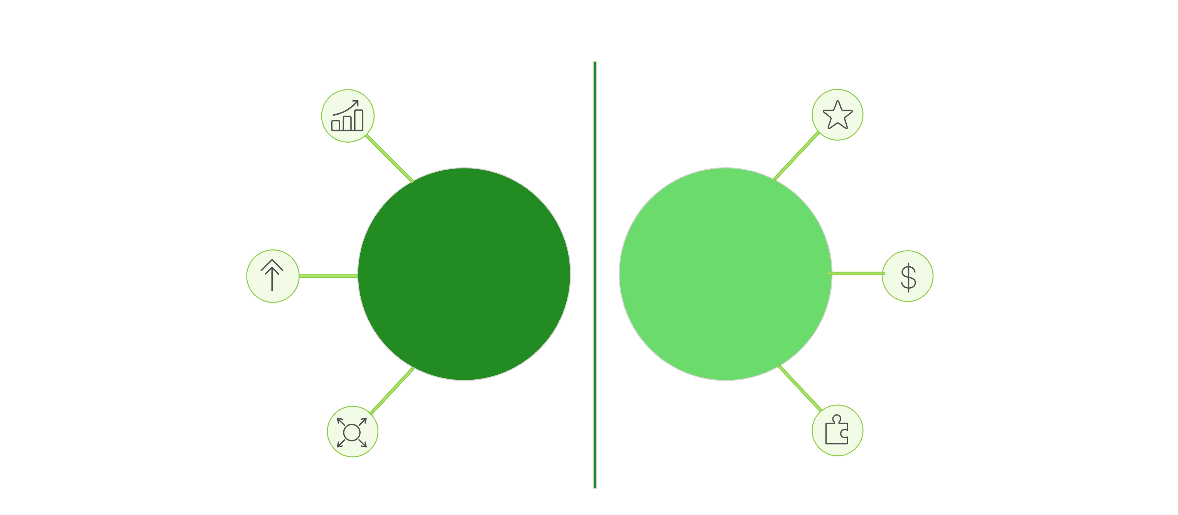
Problem Statement
Need for crop advisory, disease detection, and market insights
Provides crop advisory, disease detection, market insights, and guidance
Systems cannot directly
understand input
Problem
Solution
Uses NLP to understand queries in natural language
Difficulty in identifying key information
Identifies intent and key information (crop, disease, context)
Farmers require support for crop advisory, disease detection, market insights, and farming guidance. However, their queries are in natural language (unstructured), which makes it difficult for systems to understand and generate meaningful, context-aware responses..
AI-AgroBot is an AI-powered platform that uses NLP to understand farmer queries and convert unstructured text into structured information. It generates context-aware responses and provides crop advice, disease detection, and market insights through a simple interface.

Slide 3
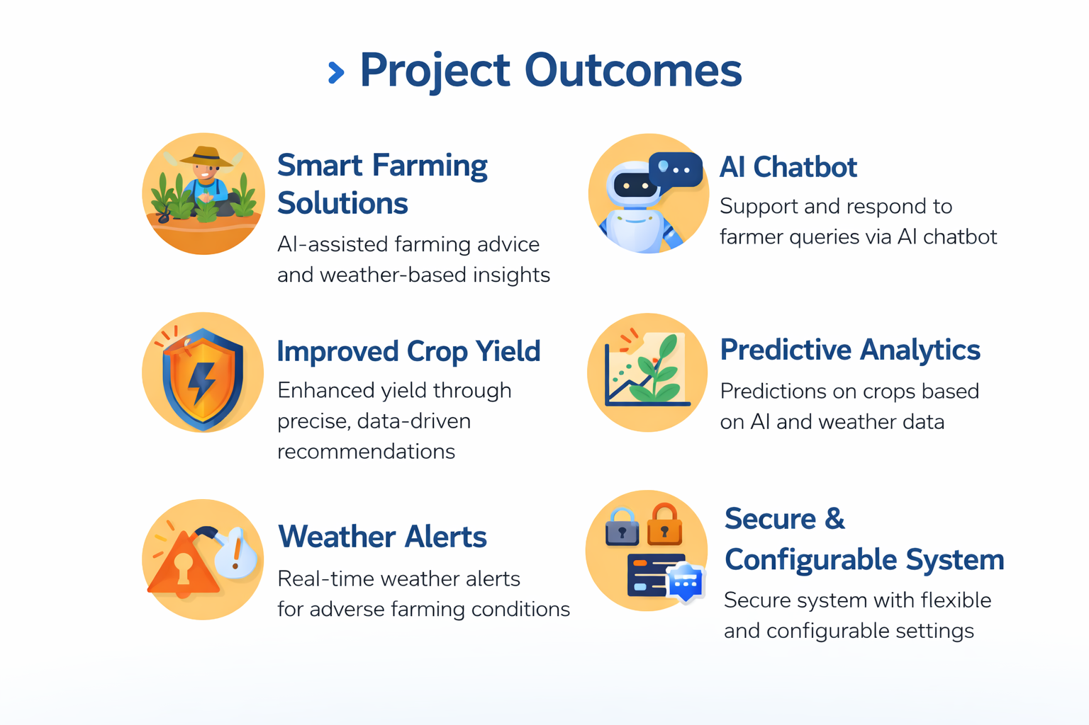

Slide 4
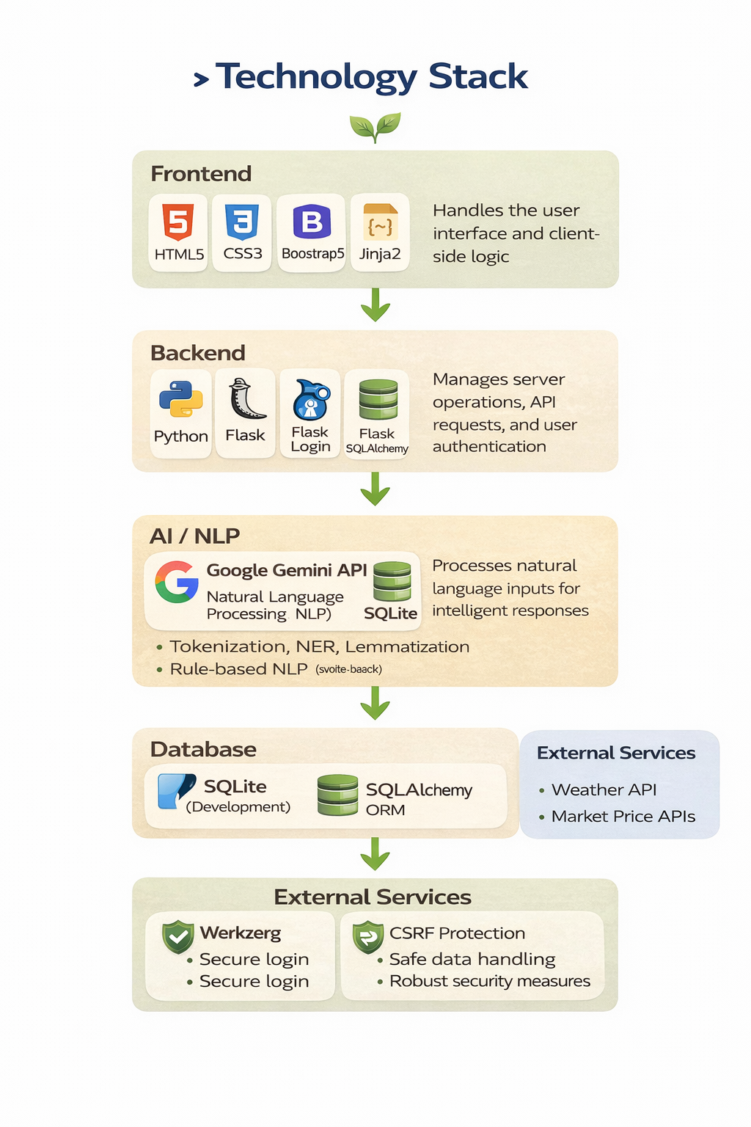
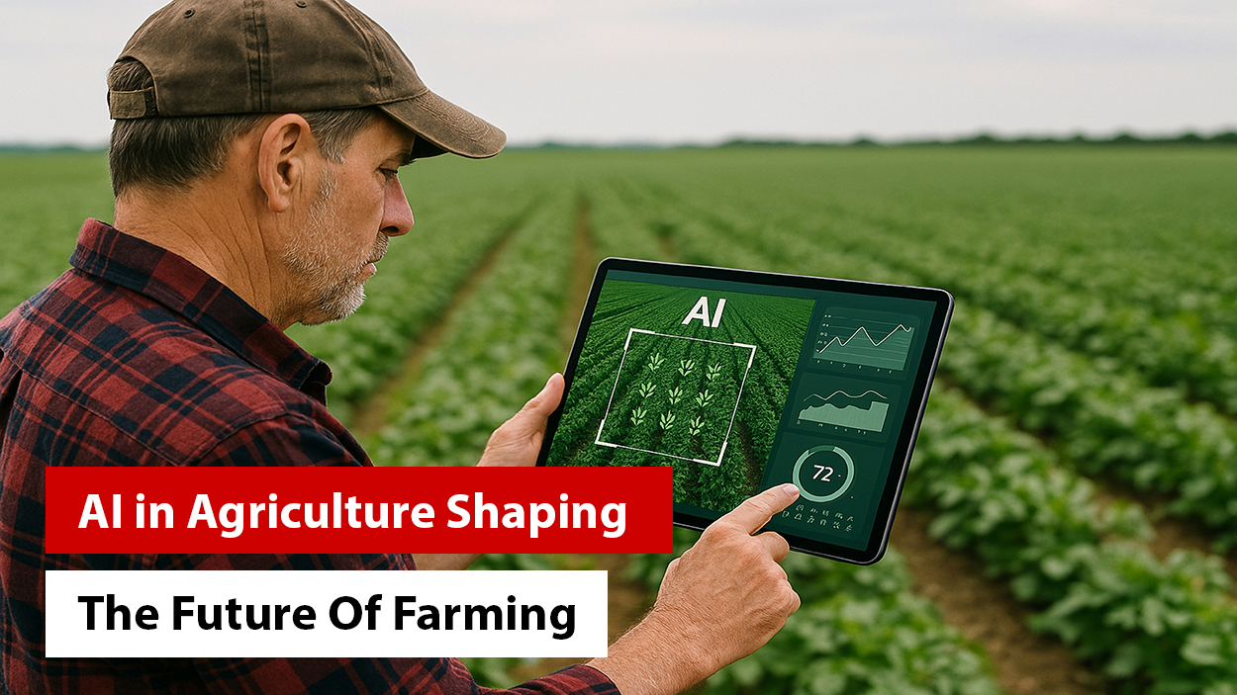
Fundraising Process
Finalization
Negotiation
VC Meetings & Due Diligence
Term Sheet
Round Closing

Slide 5
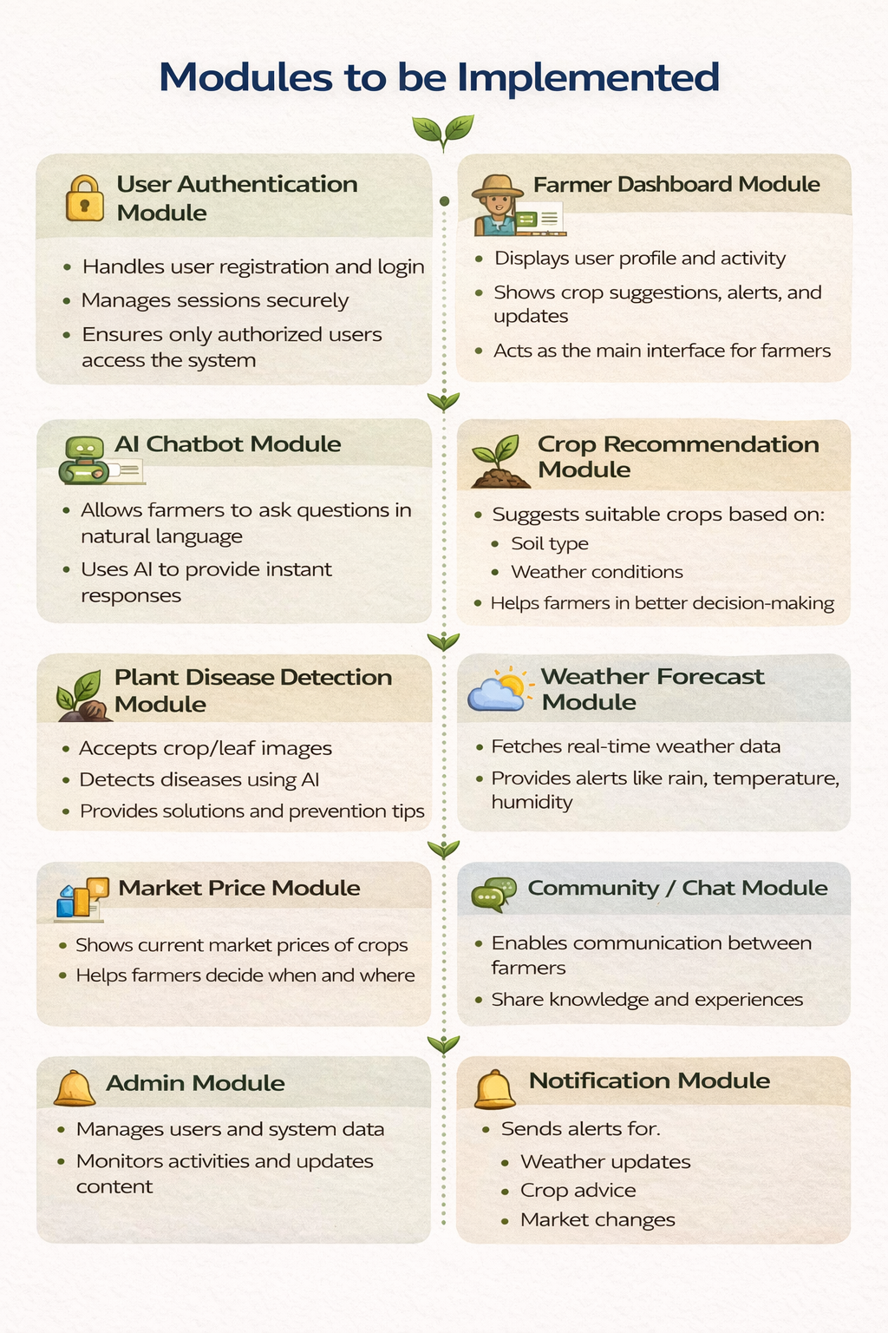
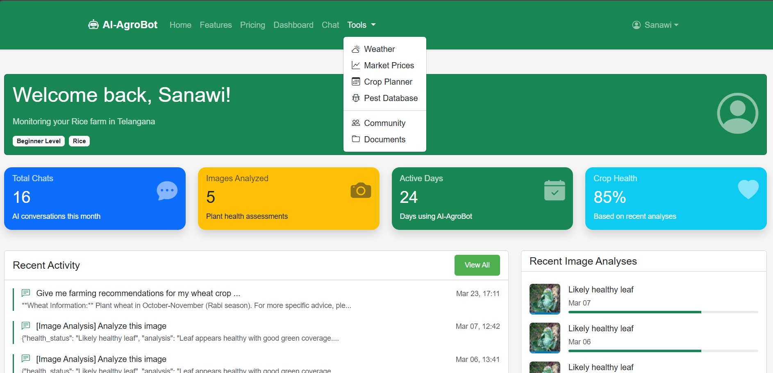

Slide 6
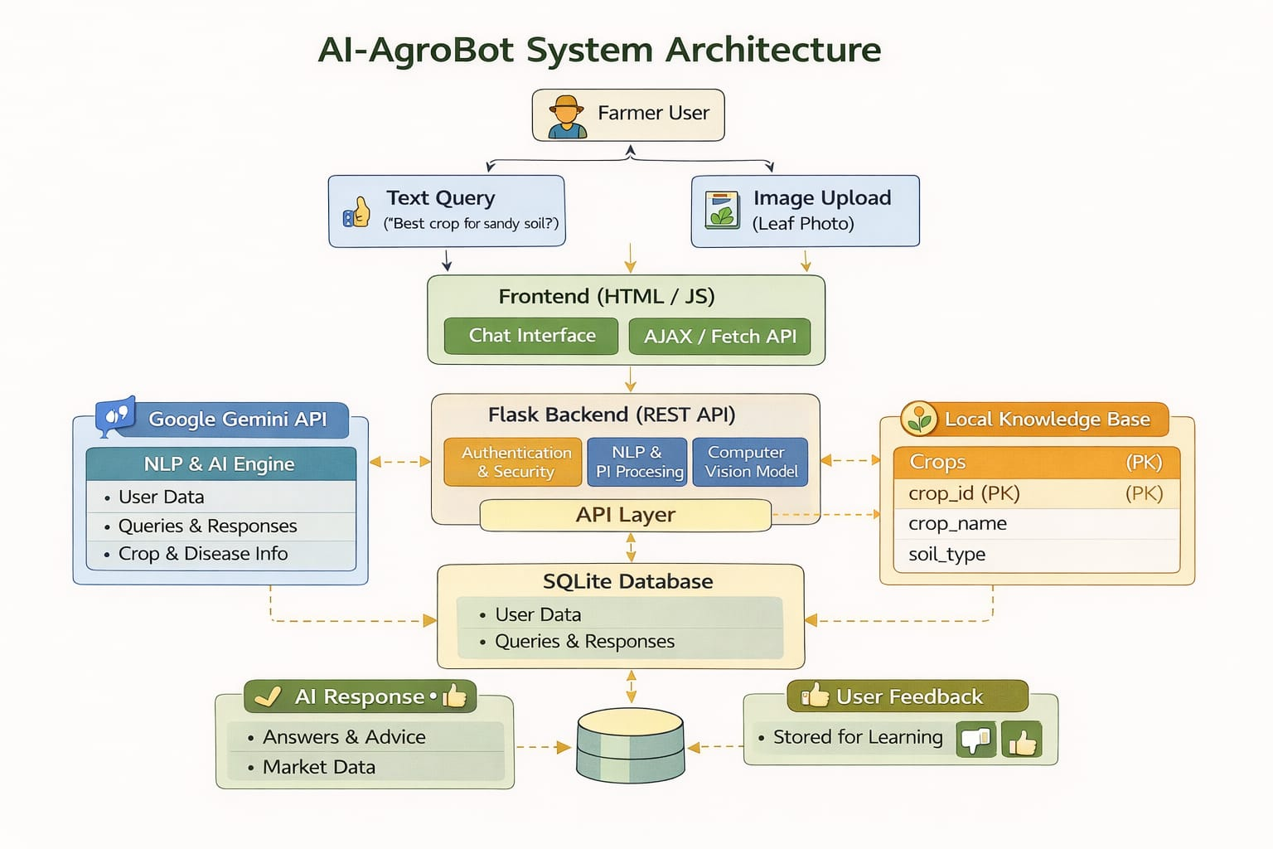

Slide 7
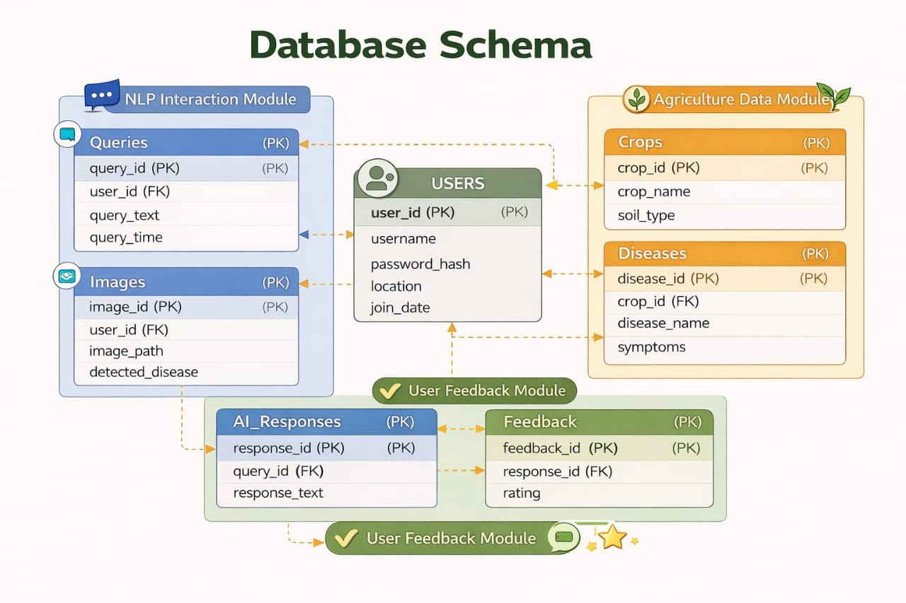

Slide 8
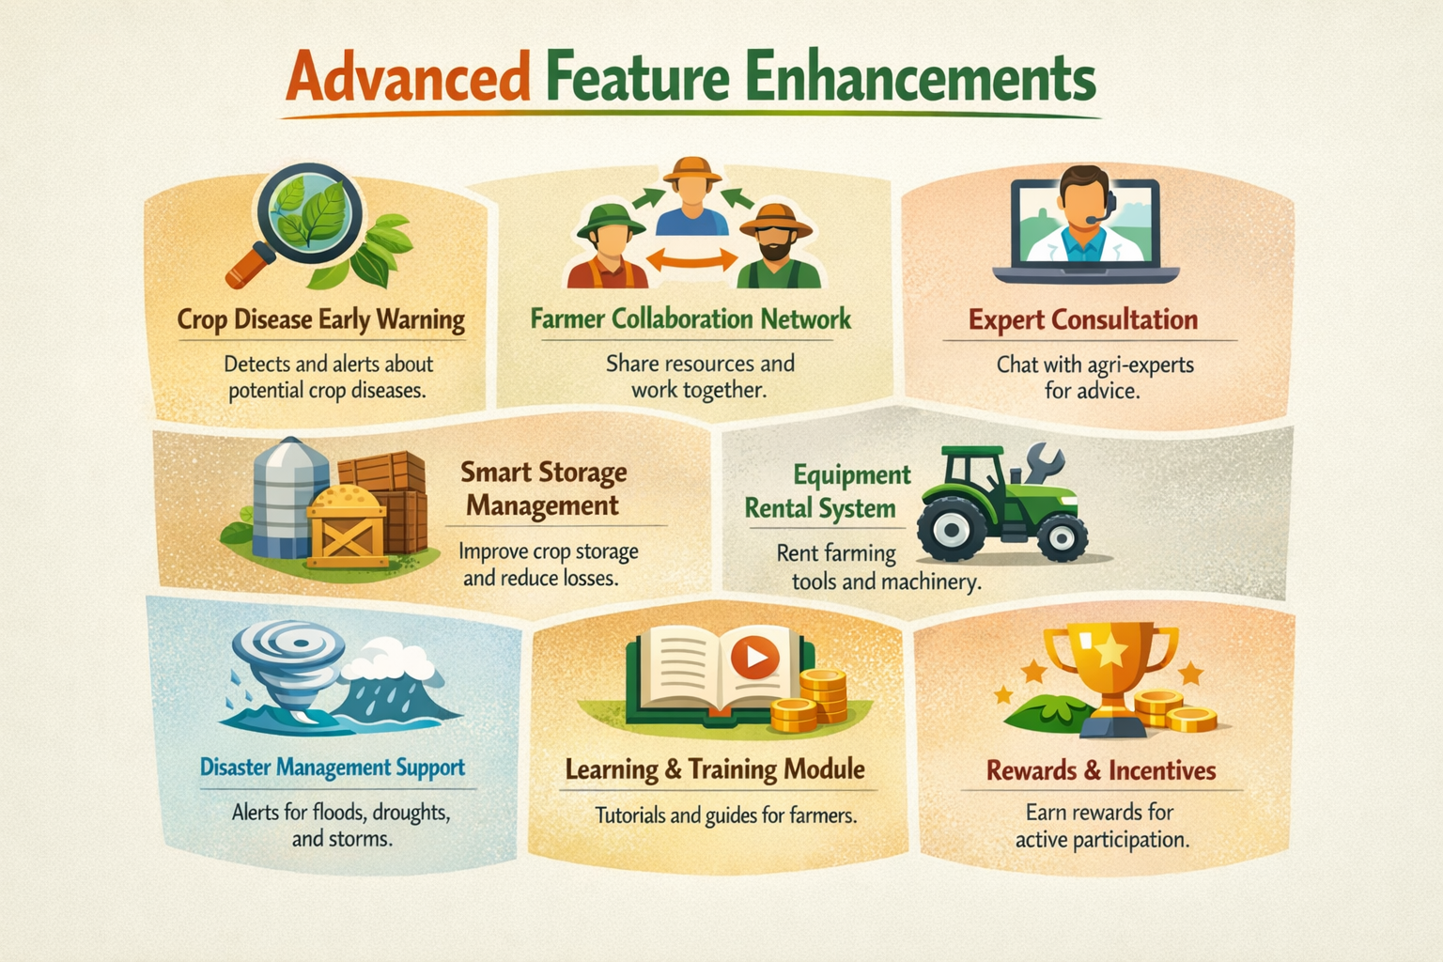

Slide 9
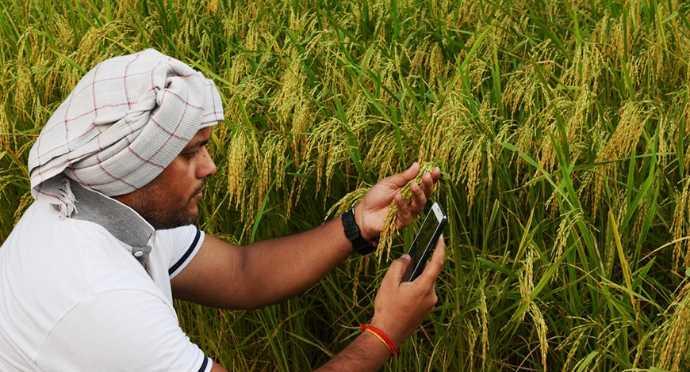
Conclusion
→ AI-AgroBot provides an intelligent and user-friendly agricultural assistance platform → Uses NLP and AI to understand queries and generate context-aware responses → Supports crop advisory, disease detection, market prices, and weather information → Allows both text and image-based interaction for better usability → Integrates additional modules like analytics, notifications, and admin management → Stores data to improve system performance over time → Helps farmers make better and informed decisions → Enhances accessibility and efficiency in agricultural support systems

Slide 10
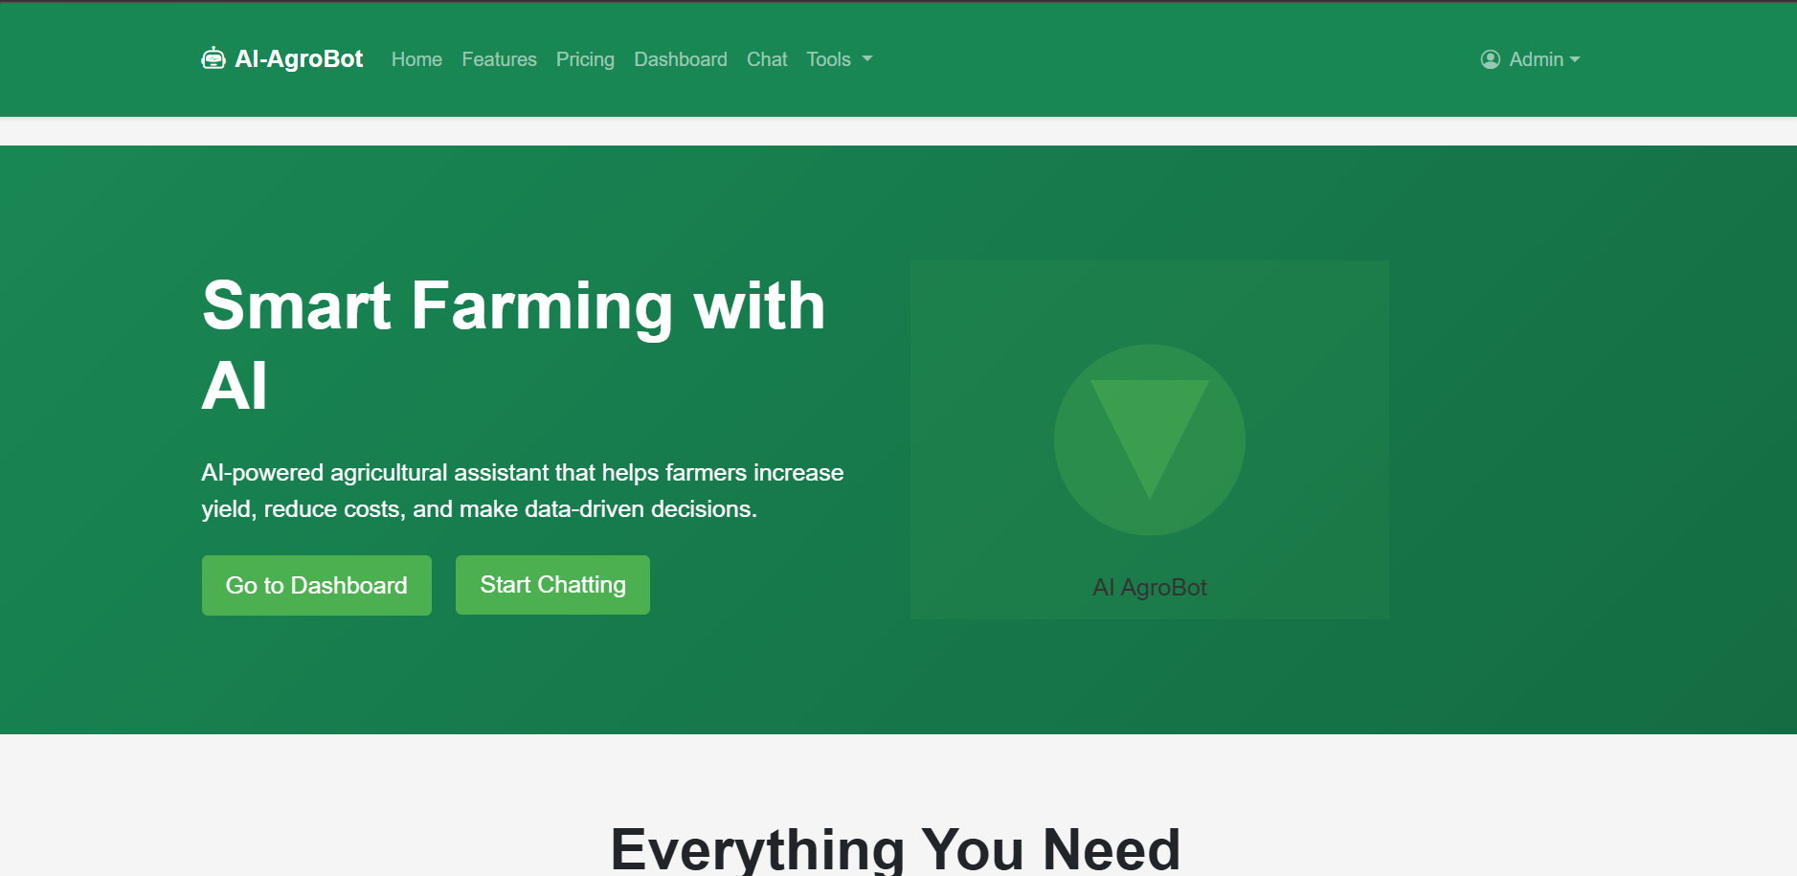
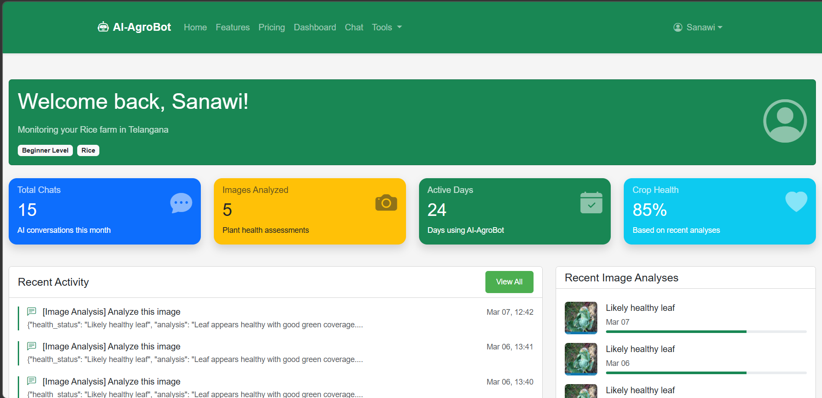
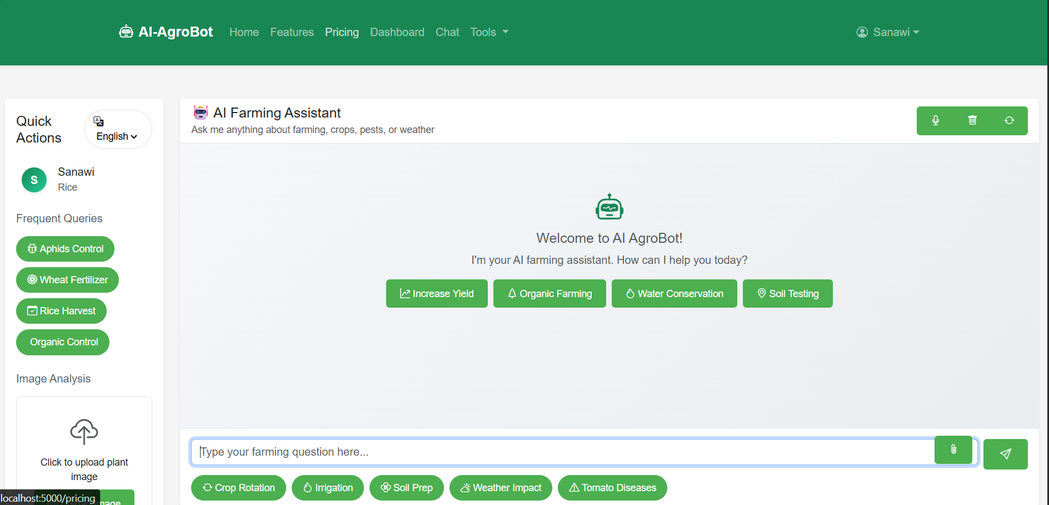
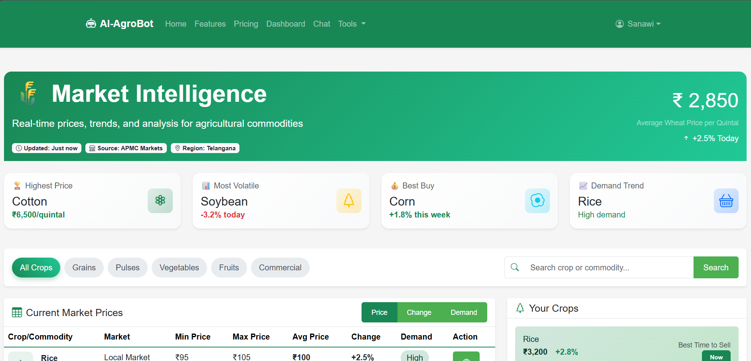
SAMPLE OUTPUTS

Slide 11
THANK YOU

